Slide 1
Scrum-Agile
A project development methodology
Aidan Farhi 06/23/24

Slide 2
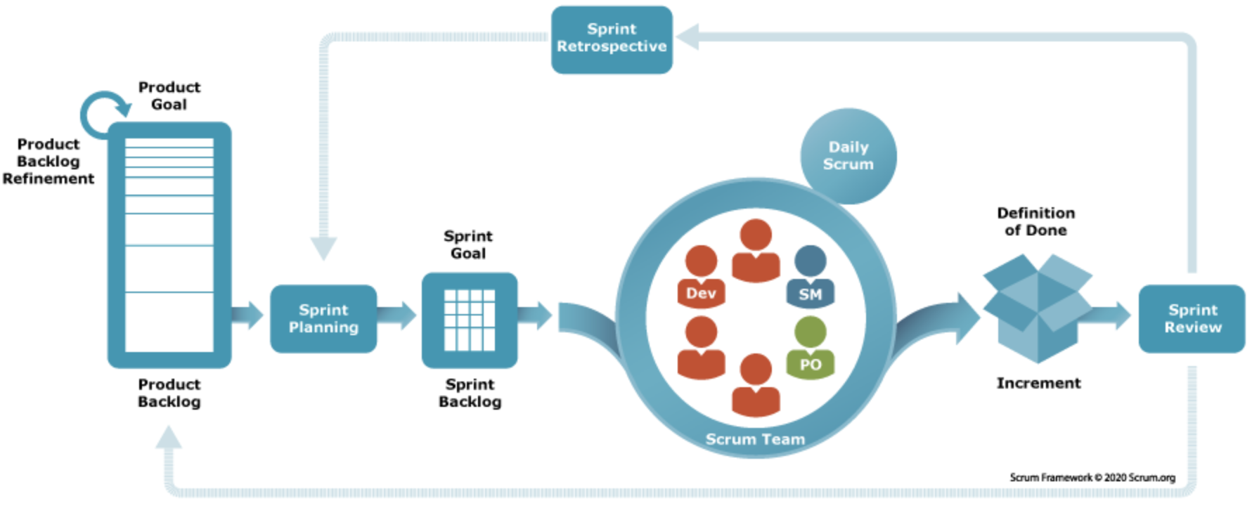
What is Scrum-Agile?
Scrum is a framework for developing projects created by Jeff Sutherland and Ken Schwaber. It is an implementation of the Agile philosophy.
Agile is a philosophy created by 17 individuals in 2001 in an effort to guide teams on better software project development.
- Srcum-Agile has a set of roles, phases, events, and artifacts that are clearly defined.
1
2
1
Scrum Guides, “About the creators of Scrum.”
2
Sacolick, “A brief history of the agile methodology.”

Slide 3

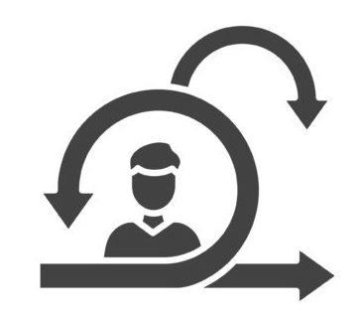

What are the Scrum Roles?
Product Owner
Scrum Master
Developer
Sole person responsible for managing the Product Backlog items (the list of “Stories” to be completed for the product).
Optimizes the value of the work of the Development team.
- Prioritizes, orders, and expresses the Product Backlog items.
Ensures that the team is adhering to Scrum theory, practices, and rules.
Facilitates Scrum events and helps with removing impediments.
- Coaches the Development Team in organization, cross-functionality, and Product Backlog management.
Implements the units of work, usually called “Stories”.
Turns the Product Backlog into increments of releasable functionality.
- Self-organizes and collaborates across the organization as needed.
6
3
4
7
9
5
8
10
3
Cobb, “The Project Manager’s Guide to Mastering Agile: Principles and Practices for an Adaptive Approach,” p. 35.
7
Ibid.
4
Ibid.
8
Ibid.
5
9
Ibid.
Ibid, p. 38.
6
Ibid, p. 36-37.
10
Ibid.

Slide 4



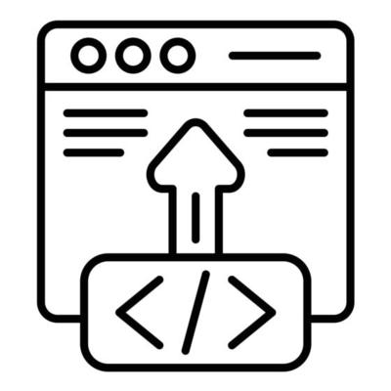
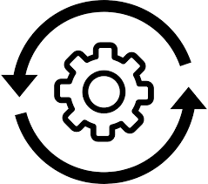
What are the Agile Phases?
In this initial phase, the Product Owner interacts with stakeholders, the business, and developers to collect requirements, define the purpose of the software, and allocates resources.
11
Ideation
Once the requirements are collected, the Development team proceeds with implementing a set of Product Backlog items and strives to meet the Sprint goal to produce a releasable product increment.
Development
After the Development team has completed their work, the Testers will ensure that the software meets all functional requirements and acceptance criteria.
Testing
Once the Developers and Testers have completed their work, the software will be released, ideally using modern CI/CD principles and practices.
Deployment
After the software is released, the team will perform ongoing maintenance. As feedback from users and developers is collected, the process will start again with Ideation, continuing the cycle.
Operations
11
Mendix, “The 5 Stages of the Agile Software Development Lifecycle.”

Slide 5
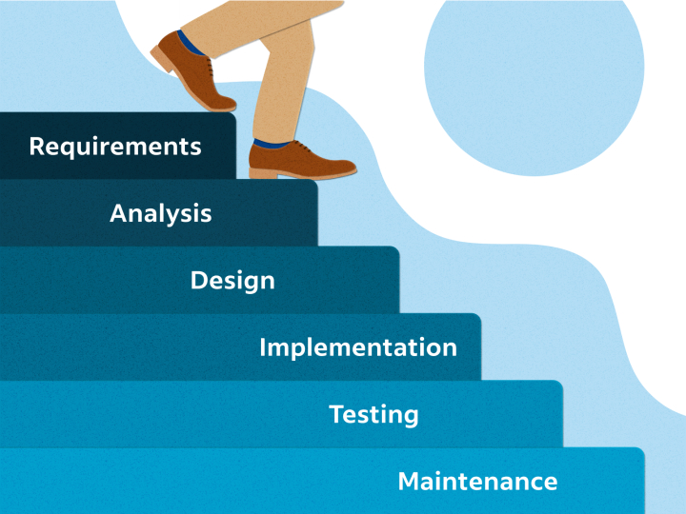
What is the Waterfall Model?
12
Waterfall is a project management framework with a set of concrete steps including:
1. Requirements
2. Design
3. Implementation
4. Verification or Testing
5. Deployment & Maintenance
In Waterfall, once one phase is complete, you must continue forward to the next one. If the stakeholder wants to introduce a change during Implementation, it is not possible. They are confined to the initial Requirements.
- It is a simple to grasp methodology that has dominated the industry for quite some time.
12
Hooray, Bottorff, “What Is Waterfall Methodology? Here’s How It Can Help Your Project Management Strategy.”

Slide 6

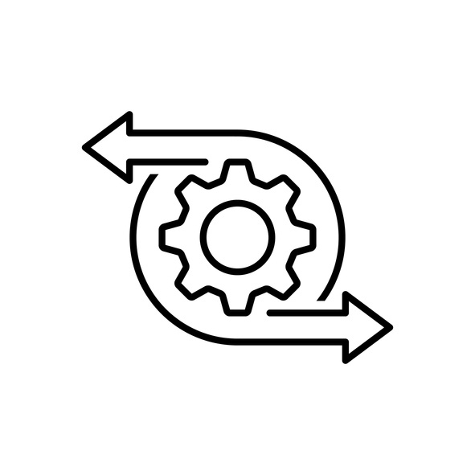
Waterfall vs. Agile
Waterfall
Agile
Simple and easy implement approach. Strict set of phases that are straightforward for project managers to explain and implement.
Not good for projects where the requirements are frequently changing. Once a phase is complete, you cannot go back.
- During the SNHU Travel project, a new feature request was introduced that would have been already to late to implement.
Needs entire organization buy-in to execute successfully. Provides an alternative to the rigid Waterfall methodology.
Good for projects that can be broken down into small and releasable units. Constantly changing requirements are able to be incorporated without much friction.
- When an unexpected requirement was brought up in the SNHU Travel project, it was trivial to update the scope of work and deliver on the request.

Slide 7
Bibliography
Scrum Guides. (n.d.). About the creators of Scrum. Retrieved June 23, 2024. https://scrumguides.org/.
Hoory, L. & Bottorff, C (2024, May 28). What Is Waterfall Methodology? Here’s How It Can Help Your Project Management Strategy. Forbes Advisor. Retrieved June 23, 2024. https://www.forbes.com/advisor/business/what-is-waterfall-methodology/.
Cobb, C. G. (2015). The Project Manager's Guide to Mastering Agile: Principles and Practices for an Adaptive Approach. Wiley. Retrieved June 16, 2024. https://web-p-ebscohost-com.ezproxy.snhu.edu/ehost/ebookviewer/ebook/bmxlYmtfXzkzNzAwOV9fQU41?sid=6c242b5d-c3f3-4436-845b-23b58a72be2e@redis&vid=0&format=EB&rid=1/.
Van Der Hock, J. (2024, April 10). The 5 Stages of the Agile Software Development Lifecycle. Mendix. Retrieved June 23, 2024. https://www.mendix.com/blog/agile-software-development-lifecycle-stages/.
Sacolick, I. (2022, April 8). A brief history of the agile methodology. InfoWorld. Retrieved June 23, 2024. https://www.infoworld.com/article/3655646/a-brief-history-of-the-agile-methodology.html/.

